Slide 1
Artificial Intelligence

Slide 2
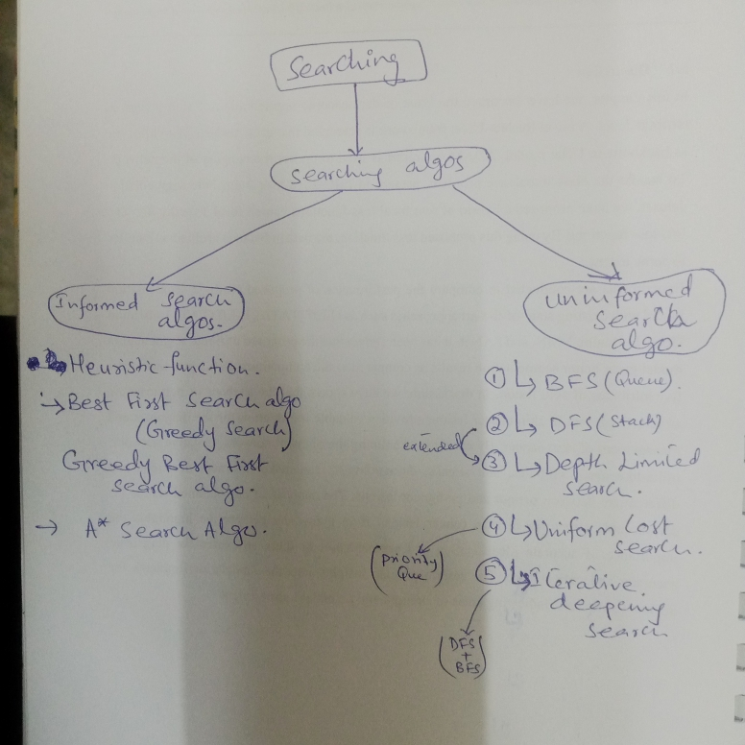
Task

Slide 3
Outline
Properties of Search Algorithms
Uninformed Search Algorithms
Breadth-first search
Depth-first search
Depth-limited search
Uniform-cost search
Iterative deepening search

Slide 4
Properties of Search Algorithms
Following are the four essential properties of search algorithms to compare the efficiency of these algorithms:
Completeness: Does it always find a solution if one exists?
Optimality: whether the algorithm found a best solution?
Time complexity: A measure of time for an algorithm to complete its task.
Space complexity: The maximum storage space required at any point during the search
Notes:
The parameters used to evaluate the performance of algorithms.

Slide 5
Uninformed Search Algorithms
Use only the information available in the problem definition
Carried out without any additional information that is already provided in the problem statement
How to traverse the tree, how to identify leaf and goal nodes
Breadth-first search
Depth-first search
Depth-limited search
Uniform-cost search
Iterative deepening search

Slide 6
Breadth-first search (BFS)
The most common search strategy for traversing a tree or graph
This algorithm searches breadthwise in a tree or graph and progresses downward level by level
The breadth-first search algorithm is an example of a general-graph search algorithm.
Breadth-first search implemented using FIFO queue data structure.

Slide 7
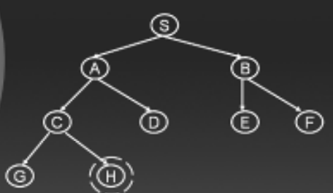
Contd..

Slide 8
Simple search algorithm
Let S be the start state
Initialize Queue (Q) with the start node Q=(S) as the only entry; set Visited = (S)
If Q is empty, fail. Else pick node X from Q
If X is a goal, return X (path), we’ve reached the goal
(Otherwise) Remove X from Q
Find all the children of state X not in Visited
Add these to Q; Add Children of X to Visited
Go to Step 2

Slide 9
Contd..
S
Add S in output, mark as visited, and make first currently working node (CWN), check for goal
Output: S
A
B
C
D
E
F
G
H
S

Slide 10
Contd..
S
If S is not goal, Check all unvisited adjacent nodes of S, enqueue them and also mark as visited
Output: S A B
A
B
C
D
E
F
G
H
A | B

Slide 11
Contd..
S
Update CWN. Check first element in Q i.e. A. make it CWN and dequeue it. Check for goal
Output: S A B
A
B
C
D
E
F
G
H
A | B

Slide 12
Contd..
S
If A is not goal, Check all unvisited adjacent nodes of A, enqueue them and also mark as visited
Output: S A B C D
A
B
C
D
E
F
G
H
A | B | C | D

Slide 13
Contd..
S
Update CWN. Check first element in Q i.e. B. make it CWN and dequeue it. Check for goal.
Output: S A B C D
A
B
C
D
E
F
G
H
A | B | C | D

Slide 14
Contd..
S
If B is not goal, Check all unvisited adjacent nodes of B, enqueue them and also mark as visited
Output: S A B C D E F
A
B
C
D
E
F
G
H
A | B | C | D | E | F

Slide 15
Contd..
S
Update CWN. Check first element in Q i.e. C. make it CWN and dequeue it. Check for goal.
Output: S A B C D E F
A
B
C
D
E
F
G
H
A | B | C | D | E | F | G | H

Slide 16
Contd..
S
If C is not goal, Check all unvisited adjacent nodes of C, enqueue them and also mark as visited
Output: S A B C D E F G H
A
B
C
D
E
F
G
H
A | B | C | D | E | F | G | H

Slide 17
Contd..
S
Update CWN. Check first element in Q i.e. D. make it CWN and dequeue it. Check for goal.
Output: S A B C D E F G H
A
B
C
D
E
F
G
H
A | B | C | D | E | F | G | H

Slide 18
Contd..
S
Check all unvisited adjacent nodes of D, No unvisited node, no enqueue, Update CWD and check for goal
Output: S A B C D E F G H
A
B
C
D
E
F
G
H
A | B | C | D | E | F | G | H

Slide 19
Contd..
Now, as there is no unvisited node left, every node left in Q will be made CWD and checked for goal, sequentially, and gets removed from the Q.
When the last node H is removed from Q and checked for goal, the algorithm says YES.
The path to achieve goal will be:
S A B C D E F G H
BFS travels a significant area of the search space if the solution is located somewhere deep inside the tree

Slide 20
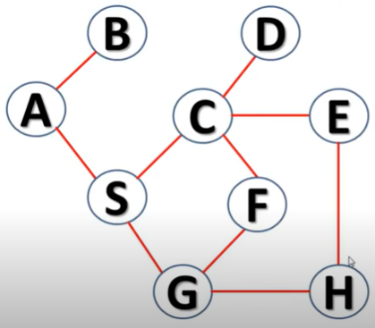
Task
Use BFS to traverse the graph starting from node A.
Notes:
Output: A B S C G D E F H

Slide 21
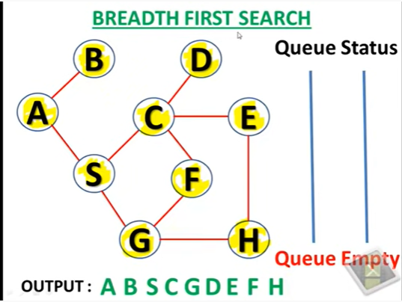

Slide 22
Depth-first search (DFS)
A recursive algorithm for traversing a tree or graph data structure.
It starts from the root node and follows each path to its greatest depth node before moving to the next path. That’s why called the depth-first search
The searching process is similar to the BFS algorithm.
DFS is implemented using LIFO i.e. stack data structure.
Flow: Root node--->Left node ----> right node.

Slide 23
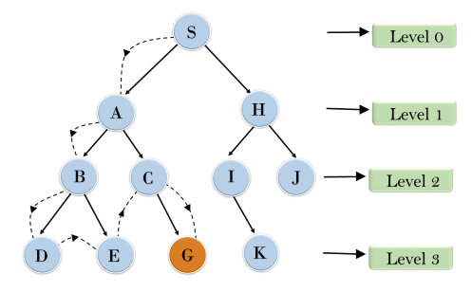
Contd..
Search from root node S->A->B->D->E,
After traversing E, it will backtrack the tree as E has no other successor and still goal node is not found. After backtracking it will traverse node C and then G, and here it will terminate as it found goal node.

Slide 24
Example
S
S
Add S in output and Stack, mark as visited, and make first currently working node (CWN), check for goal
Output: S
A
B
C
D
E
F
G
H

Slide 25
Example
S
A
S
If S is not goal, check next unvisited deepest adjacent node i.e. A. push A and also mark as visited
Output: S A
A
B
C
D
E
F
G
H

Slide 26
Example
S
C
A
S
If A is not goal, check next unvisited deepest adjacent node i.e. C. push C and also mark as visited
Output: S A C
A
B
C
D
E
F
G
H

Slide 27
Example
S
G
C
A
S
If C is not goal, check next unvisited deepest adjacent node i.e. G. push G and also mark as visited
Output: S A C G
A
B
C
D
E
F
G
H

Slide 28
Example
S
G
C
A
S
If G is not goal, check next unvisited deepest adjacent node. No node. pop G.
Output: S A C G
A
B
C
D
E
F
G
H

Slide 29
Example
S
H
C
A
S
The next node in stack is C. backtrack, check next unvisited deepest adjacent node of C i.e. H. push H and mark visited Output: S A C G H
A
B
C
D
E
F
G
H

Slide 30
Contd..
As H is the goal, so, it will stop and pop the nodes from stack.
The path to achieve the goal is :
S A C G H
To traverse all the nodes:

Slide 31
Example
The next node in stack is now, H. check next unvisited deepest adjacent node. No node. Pop H, C. Now A has one unvisited node D, push D and mark visited Output: S A C G H D
S
D
H
C
A
S
A
B
C
D
E
F
G
H

Slide 32
Example
The next node in stack is now, D. No unvisited deepest adjacent node. Pop D, A. Now S has one unvisited node B, push B and mark visited
Output: S A C G H D B
S
B
D
A
S
A
B
C
D
E
F
G
H

Slide 33
Example
The next node in stack is now, B. Two unvisited deepest adjacent node. Push E and mark visited
Output: S A C G H D B E
S
E
B
S
A
B
C
D
E
F
G
H

Slide 34
Example
The next node in stack is now, E. No unvisited deepest adjacent node. Pop E. Now B has one unvisited node F. push F and mark visited
Output: S A C G H D B E F
S
F
E
B
S
A
B
C
D
E
F
G
H

Slide 35
Example
The next node in stack is now, F. No unvisited deepest adjacent node. Pop F. Similarly pop B and finally S.
Output: S A C G H D B E F
S
F
B
S
A
B
C
D
E
F
G
H

Slide 36
Contd..
So, the whole tree is traversed using DFS and the path is:
S A C G H D B E F

Slide 37
Task
Use DFS to traverse the graph starting from node A.

Slide 38
Depth-Limited Search Algorithm

Slide 39
Depth-Limited Search Algorithm
Similar to depth-first search with a predetermined limit, to guarantee that the algorithm ends.
The node at the depth limit will be treated as it has no successor nodes further.
Can solve the drawback of the infinite path in the DFS
Can be terminated with two Conditions of failure:
Standard failure value: It indicates that problem does not have any solution.
Cutoff failure value: It defines no solution for the problem within a given depth limit (terminates on reaching predetermined depth) even if solution found.

Slide 40
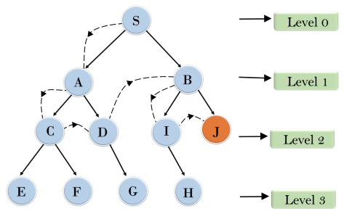
Contd..
An example with depth limit of 2.
Will traverse downward until level 2. if finds goal, terminates otherwise expand downwards by increasing depth limit (Level number)

Slide 41
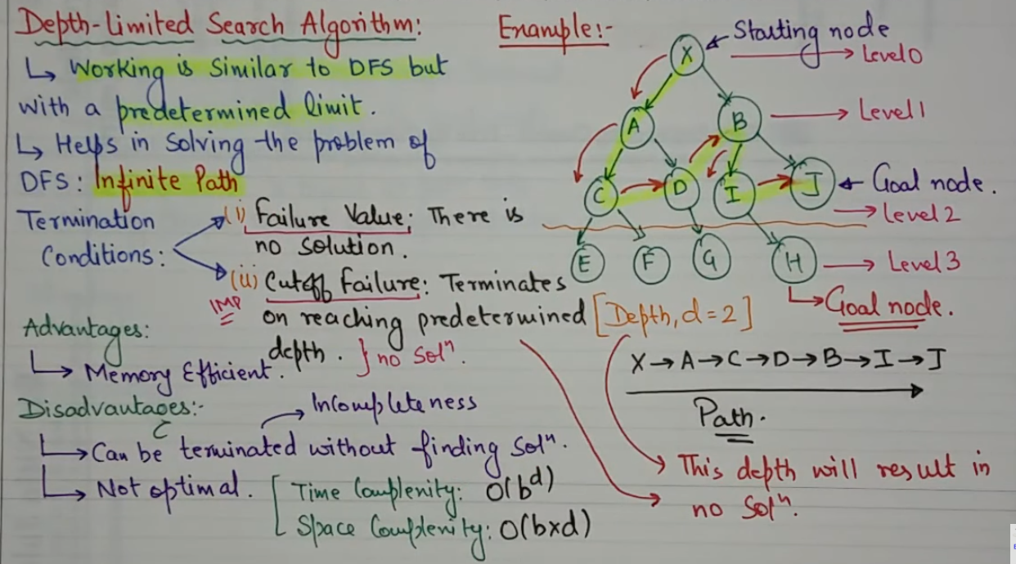

Slide 42
Pros and Cons
Advantages
Depth-limited search is Memory efficient.
Disadvantages
Depth-limited search also has a disadvantage of incompleteness (can be terminated without finding solution).
It may not be optimal if the problem has more than one solution. Means its not compulsory it will give you best solution.

Slide 43
Uniform-cost Search

Slide 44
Uniform-cost Search
A searching algorithm to traverse a weighted tree or graph
A different cost is available for each edge
The primary goal is to find a path to the goal node, having the lowest cumulative cost
It searches next nodes according to their path costs
Implemented by the priority queue.
i.e. It gives maximum priority to the lowest cumulative cost

Slide 45
Pros and Cons
Advantages
optimal because at every state the path with the least cost is chosen.
Disadvantages
It does not care about the number of steps involved in searching and only concerned about path cost.

Slide 46
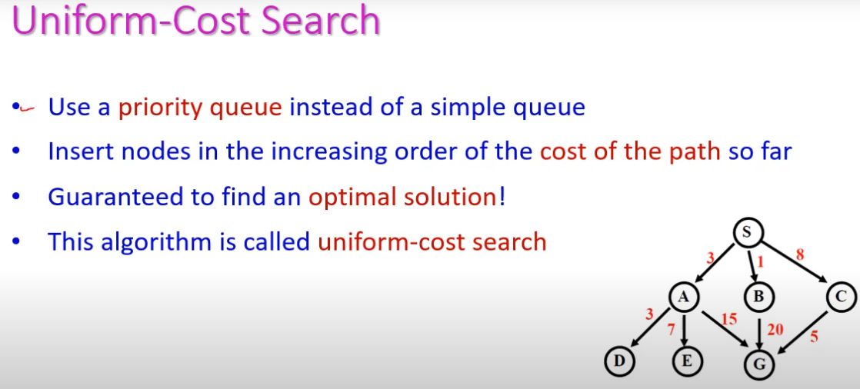
Example

Slide 47
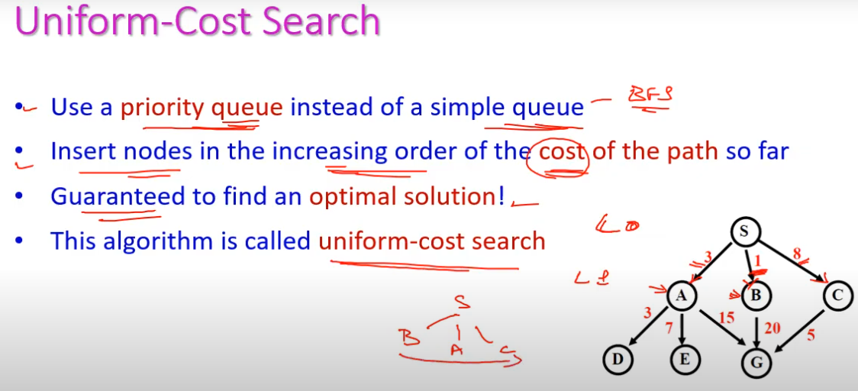
Example

Slide 48
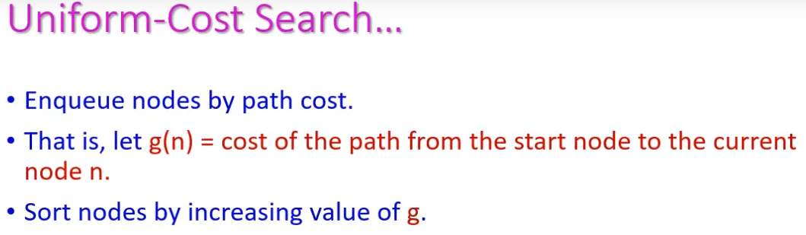
Example

Slide 49
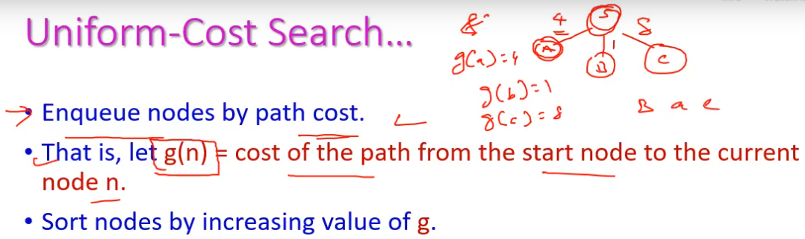
Example

Slide 50
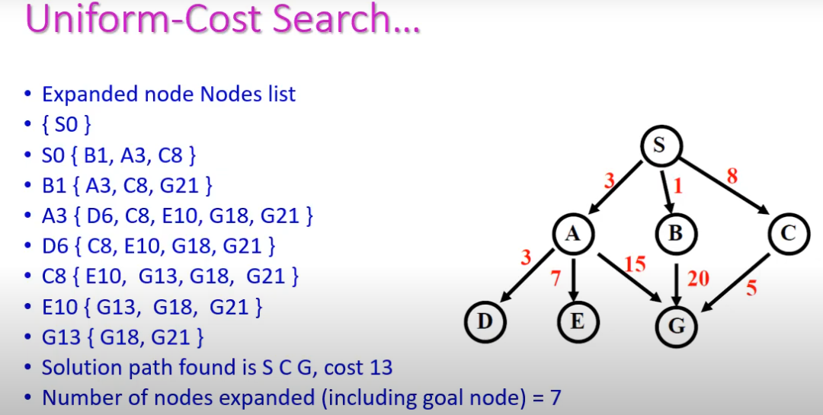
Example

Slide 51
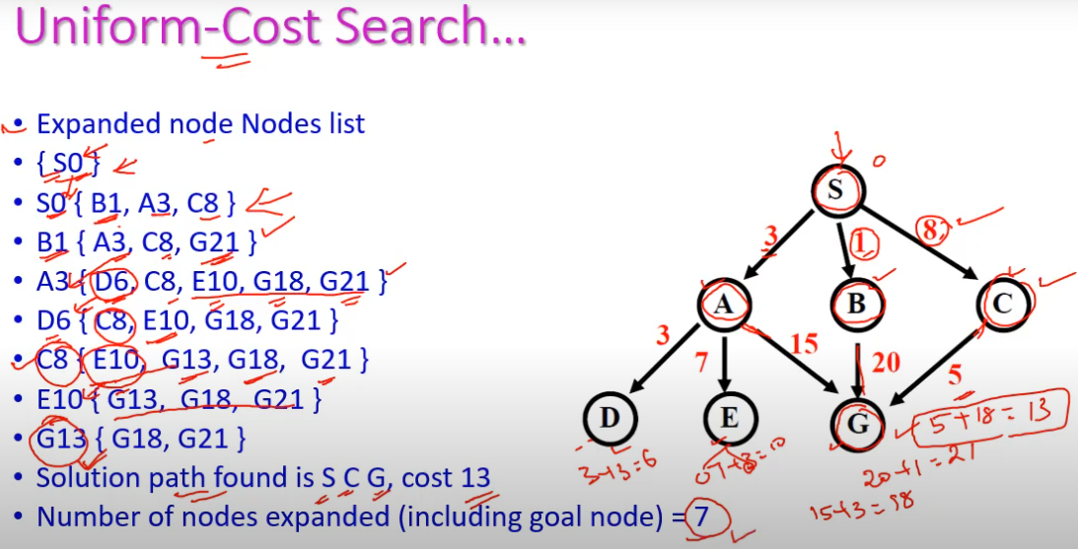
Example

Slide 52
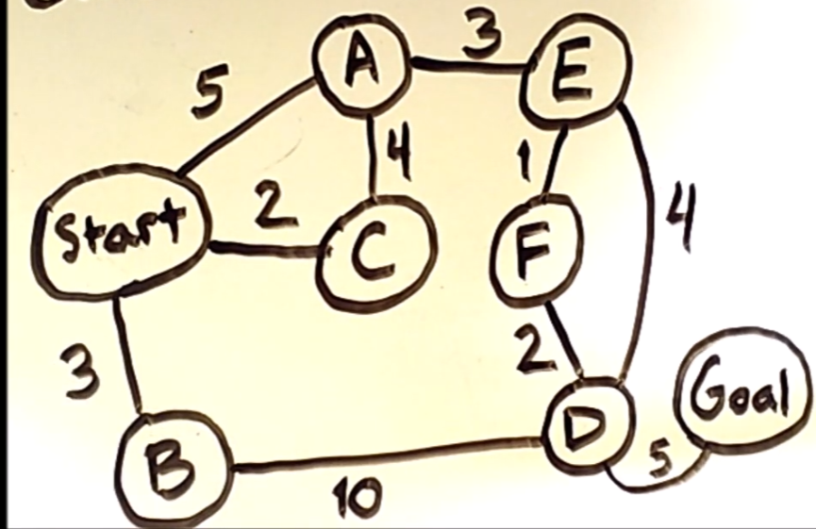
Example

Slide 53
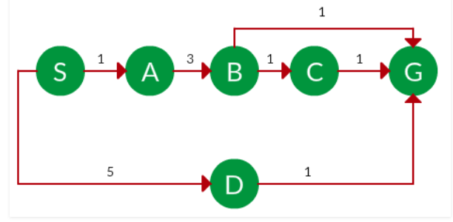
Task
Find the best path and also calculate the cost.

Slide 54
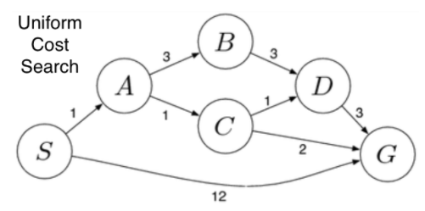
Optimal Solution??

Slide 55
Iterative deepening Depth First Search(IDDFS)

Slide 56
Iterative deepening Depth First Search(IDDFS)
A combination of DFS and BFS algorithms
It searches for the best depth in each iteration
Searches until a certain depth and the depth keeps increasing at every iteration until it reaches the goal state.
Advantages:
It combines the benefits of BFS and DFS search algorithm in terms of fast search and memory efficiency.
Disadvantages:
Main drawback is that it repeats all the work of the previous phase.

Slide 57
Iterative deepening Depth First Search(IDDFS)
With BFS, it expands.
With DFS, it performs search in depth of all expanded breadth.

Slide 58
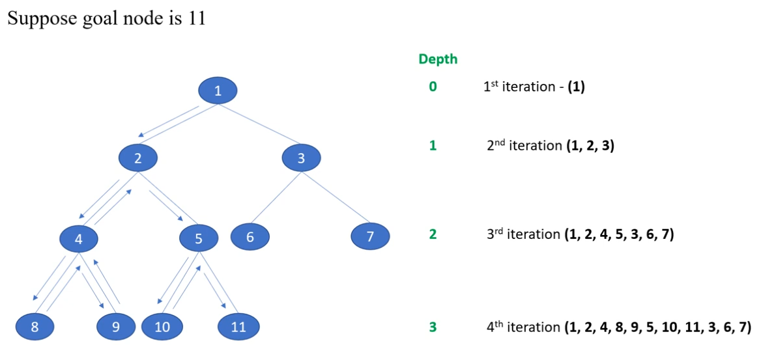
Example

Slide 59
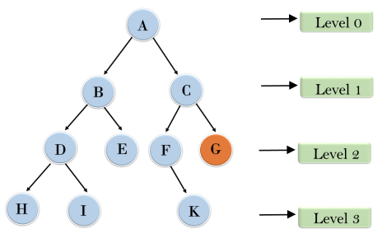
Contd..
1'st Iteration-----> A 2'nd Iteration----> A, B, C 3'rd Iteration------>A, B, D, E, C, F, G 4'th Iteration------>A, B, D, H, I, E, C, F, K, G In the fourth iteration, the algorithm will find the goal node.

Slide 60
Task

